Slide 1

The Amistad Movement
Human Trafficking 101: Community Prevention
©2019 United States Conference of Catholic Bishops
This PowerPoint presentation was created by the U.S. Conference of Catholic Bishops Anti-Trafficking Program, which owns the copyright in the presentation. It cannot be edited without the prior written consent of the USCCB. If you would like to make any adjustments to the content, please contact us at MRSTraff@usccb.org to request authorization. Unless downloaded directly from the Bridging Refugee Youth and Children's Services (BRYCS) website, USCCB/MRS cannot be responsible for ensuring the content of the presentation has not been changed.
Notes:
The Amistad Movement educates men, women, and youth who are immigrants in the United States on human trafficking so they know the signs of this crime and can protect themselves and their loved ones from falling victim.

Slide 2

The Amistad Movement
Notes:
You may be asking - Why do we call this workshop Amistad?
Amistad got its name from a slave ship. The Amistad was a Spanish ship from the 1800s that was being used to transport illegally captured Africans that had been sold into slavery in Cuba. The captured slaves took control of the ship, and their right to freedom was later reaffirmed by the U.S. Supreme Court!
This course reaffirms every person’s right to freedom and empowers individuals by giving them knowledge on how to protect themselves, their families, and their communities from exploitation and human trafficking.
This is especially important for immigrants, who often work for industries that are poorly regulated, such as agriculture, domestic/in home care, and hospitality.

Slide 3

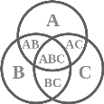
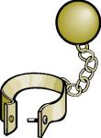


Agenda
Introduction to Human Trafficking: Sex Trafficking and Forced Labor
The Difference between Human Trafficking and Smuggling
How Traffickers Control Victims
Who is at Risk?
How to Spot Trafficking and Protect Yourself
How to Get Help
Notes:
Today we will discuss what human trafficking is. We will look at sex trafficking and forced labor and how they are different from human smuggling.
We will talk about how traffickers control their victims, who is at risk, how to spot a possible trafficking situation, and most importantly – how to keep yourself, your family, and your community safe.
Finally, we will also review what to do if you or someone you know becomes a victim, particularly who you can call or talk to for help and assistance.

Slide 4
Have you heard of Human Trafficking? What does human trafficking mean to you?
Notes:
Facilitator instructions: Ask participants what they think it means and what words come to mind. Remember: some people may have never heard the term.

Slide 5
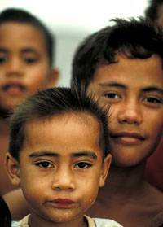

What is Human Trafficking?
Human Trafficking is a…
● modern day form of slavery
● violation of human rights
● federal crime in the U.S.
● crime in many states
Notes:
Human trafficking is a modern-day form of slavery and violates a person’s human rights,
How does human trafficking destroy a person’s human rights? It takes away people’s basic freedoms in order for a criminal to make money.
Human Trafficking is illegal and a serious crime in the United States.

Slide 6
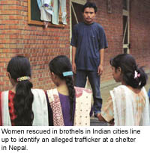
What is Human Trafficking?
A person is obligated to work against his will for very little money or no money at all
Two Types: Sex Trafficking and Labor Trafficking
How are victims controlled?
Notes:
According to U.S. law (and in many other countries) human trafficking occurs when a person is exploited to work against his or her will for little or no money at all.
If a person is forced, tricked, or threatened to work in the sex trade, he or she is considered a victim of sex trafficking.
If a person is forced, tricked, or threatened to provide any other type of work or services, this is called labor trafficking or forced labor. There are many industries where we see forced labor happening in the U.S. We will go over these together soon.
What is the most important point for us all to remember? In sex trafficking and labor trafficking, a victim’s body and/or work are being utilized for the economic benefit of a criminal, also known as a trafficker.

Slide 7
Three Types of Control
Force
Rape, beatings, starvation, and confinement (not allowed to leave place of work).
Fraud
False offers of employment, marriage, or a better life.
Coercion
Threats of serious harm to the victim, the victim’s family and loved ones.
Threats of deportation or reporting to the police or immigration
Notes:
Most traffickers trap their victims without ever locking them up. Force, Fraud, and Coercion are the 3 strategies that victims use to control their victim. They use these mechanisms to lure, scare, and keep victims in their grasp.
Note that only one of the methods uses physical violence. It is a common misunderstanding to believe that all control requires physical abuse. Though traffickers do exert physical harm, it is not the only type of trauma that can be enforced.
Facilitator instructions: Take some time to make sure the group understands the following:
Force: In addition to physical abuse, force can mean confinement. This is when a victim is not allowed to leave their place of work. Sometimes food, drink, access to bathrooms, and a place to sleep is denied to them
Fraud: Fraud refers to false offers/promises of employment with a good wage, a marriage, or a better life overall. Once the victim arrives at their destination or work site, they found that all the promises were lies.
Coercion: Coercion is another word for threats - threats of harm or deportation. These threats can be used against the victim or their family members and loved ones.

Slide 8

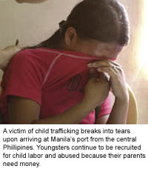
Examples of Control: No Chains Needed
Prevent trafficked person from earning enough to pay off debt, keep adding charges to debt
Restrict communication with outside world
Drug or alcohol dependency
Take away identification documents
Move victim from place to place
Notes:
Facilitator instructions: Encourage participants to think of additional examples of how victims of human trafficking are forced to perform commercial sex acts and/or work. Ask for specific examples of force, fraud and coercion. Discuss the following examples on the slide:
Debt bondage:
Traffickers loan the victim money with very high interest rates, making it almost
impossible to pay off. The trafficker might also subtract money from the victim’s salary by charging very high prices for food, rent, equipment, and travel. The victim is never able to meet their obligations and feels indebted to continue working without an end in sight.
Restrict communication:
The victim is not able to communicate or talk with anybody, especially family or friends.
Drug/alcohol addiction:
The trafficker might encourage or even force the use of these substances, so the victim remains dependent.
Seizure of identification documents:
Traffickers will take away or offer to keep a worker’s identification documents “safe”.
Constant movement:
This makes the victim confused and disoriented.

Slide 9
Trafficking and Smuggling
Trafficking
Consensual
Crime against a country
Movement across an international border to facilitate unlawful entry
Usually involves a fee
Relationship ends when smuggling is completed
Use of force, fraud, or coercion
Crime against a person
Need not involve movement
Recruiting, obtaining, transporting a person for commercial sex, labor, or services
Smuggling
Notes:
Smuggling and trafficking are often confused with one another, but they are actually very different. Sometimes smuggling can turn into trafficking, which is why it is important for us to discuss the difference between the two!
First, human smuggling is consensual. That means both parties agree to participate. Smuggling happens when a person asks a smuggler to help cross an international border without permission.
Since permission was not granted to cross the border, it is considered a crime against a country. Also, smuggling usually involves a fee. For example, a group of smugglers may charge money from migrants to drive them across the border to another country and skip the official entry requirements.
Finally, the relationship between the smuggler and the person who paid to be transported ends when the entry into the destination country is complete.
Human trafficking, on the other hand, is never consensual. As we have seen, a person is forced to provide commercial sex, labor or services fraud. Therefore, it is a crime against a person. Also, human trafficking does not always involve crossing borders. Trafficking can also happen in the same city or town where a person lives!
OJO: It is possible for human smuggling to turn into human trafficking. This can happen when the smuggler does not end the relationship once the person enters into the new country. Instead, the smuggler demands that the person perform sex acts, labor or services for them or someone else. This often occurs when the smuggler says that the person is not done paying the “debt” owed for help crossing the border.

Slide 10
Where Are People Trafficked?
Pornography
Construction
Massage Parlors
Restaurants
Nail salons
Strip Clubs
Meat Packing
Street Prostitution
Notes:
Facilitator instructions: Ask the group, “What are some of the types of jobs or industries that you think might have trafficking?” Get responses before showing this list. Also mention that trafficking can happen anywhere, not just these places. There is even trafficking in unexpected places such as teachers (foreign on H2B visas) and circus workers.

Slide 11
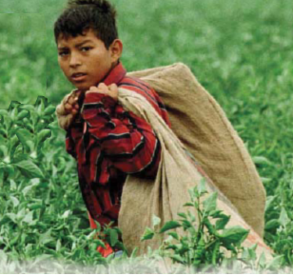
Examples of Labor Trafficking
Restaurants
Agriculture
Dairy farms
Cleaning hotels, stores, and offices
Domestic work in private houses
Notes:
As you can see, the places we just discussed are diverse. Trafficking can happen almost anywhere.
Here are more examples of jobs where people have been trapped into labor trafficking.
Many victims in these jobs are immigrants. That is because these industries are often poorly regulated. That means there are either very few laws governing these industries to protect workers or it is hard for the government to enforce the laws.

Slide 12
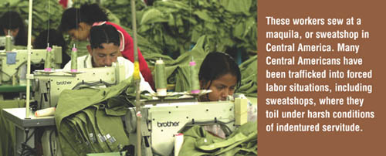
Examples of Labor Trafficking
Factory work or maquiladoras
“sweat shops”
Producing, transporting and selling drugs
Notes:
As you can see, the places we just discussed are diverse. Trafficking can happen almost anywhere.
Here are more examples of jobs where people have been trapped into labor trafficking.
Many victims in these jobs are immigrants. That is because these industries are often poorly regulated. That means there are either very few laws governing these industries to protect workers or it is hard for the government to enforce the laws.

Slide 13
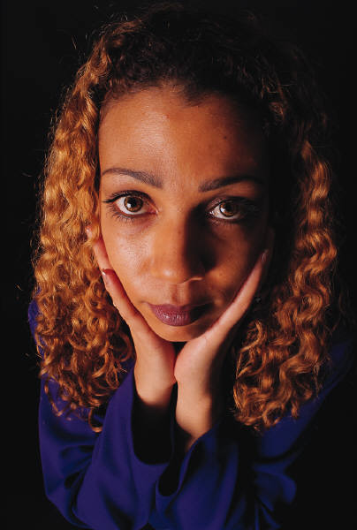
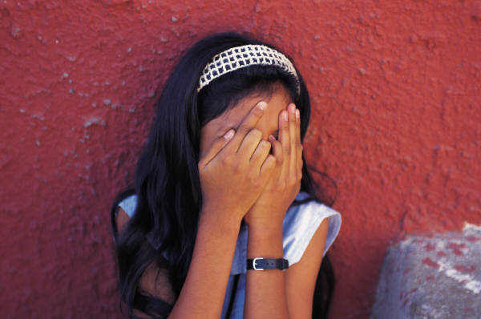
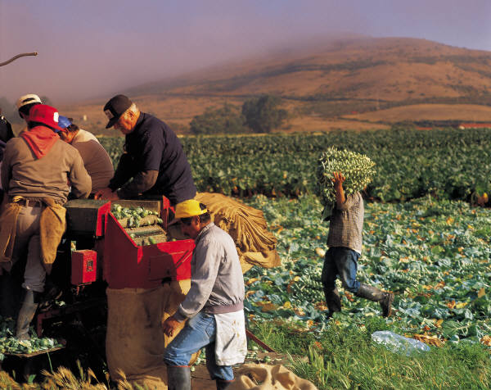
Is There a Typical Victim?
Notes:
Facilitator Instructions: Ask the group what type of people come to mind when they imagine a trafficking victim? Adult? Child? Gender? Age? Ethnicity?
Then explain that in general, victims are varied. Some are educated, while others have no formal education. Victims include men, women, and children that have been trafficked as individuals, families, or groups. Trafficking victims can be documented or undocumented and come from many different countries. Victims are also different in age, race, class, gender, religion, and culture. There is no set profile for a victim of human trafficking.

Slide 14
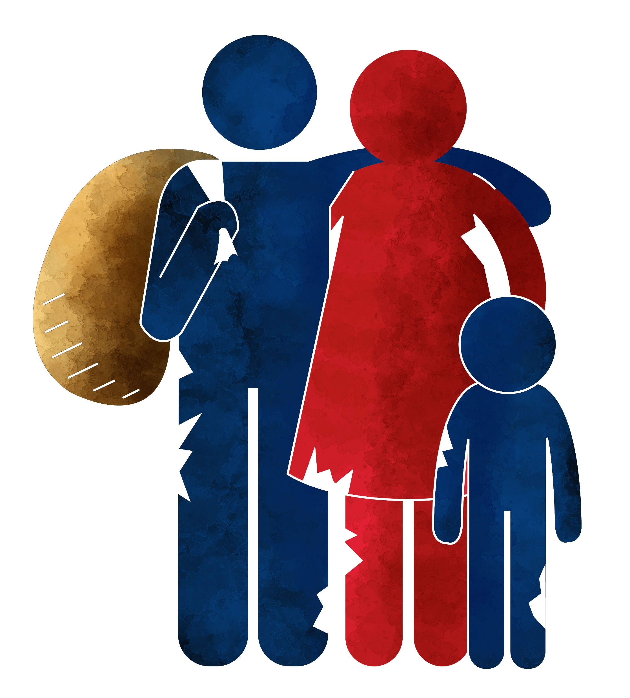
A Vulnerable Group
This crime is dangerous for:
Legal immigrants
Immigrants without documentation
Immigrant youth
Youth without documents
Notes:
This crime can happen to anyone. However, there are groups of people that are extra vulnerable to exploitation and trafficking. One of those groups are immigrants, whether they are living in the United States with papers or without. Immigrant youth are also easily targeted.
Why does this happen? Traffickers always look for people with vulnerabilities to exploit. They know that men, women, and children who are new to this country are unfamiliar with the laws and rights that protect them.
They also know that immigrants often come to the United States looking for not only safety, but for economic opportunities. They know that immigrants often need to find a job quickly to help their families who are in need. Traffickers take advantage of this need by offering them false promises of a better life.

Slide 15

What Draws Victims?
False promises of…
A good job
Opportunity to provide for family
Educational opportunities
Better life
Love
Marriage
Notes:
Victims can be drawn in for a variety of reasons such as: better opportunities to provide for their family, educational opportunities, love, marriage, and a better life in general. The vulnerability that victims are subjected to can increase their dependency on someone who makes false promises.

Slide 16

What Are Some Challenges to Finding Victims?
Lack of understanding and lack of awareness about human trafficking
Law enforcement and others who may come into contact with victims are not trained
Trafficking victims rarely self-identify
Traffickers may be well known in the community
Notes:
There several obstacles to identifying victims of human trafficking. First, there is a lack of understanding and awareness about human trafficking. If people do not know that trafficking is a problem around them, they will not be able to recognize it.
Another challenge is that trafficking victims rarely self-identify. In other words, they don’t realize they are a victim.
Finally, a trafficker may be well known in the community. He or she could be an important community member who nobody suspects as a trafficker committing this horrific crime.

Slide 17

Signs of Human Trafficking
Limited contact with family or friends
Unable to leave the work environment
Someone controlling where they go
Not being allowed to speak for themselves
Show fear or anxiety
Act as if they are instructed by someone else
Receive little or no payment
Work excessively long hours over long periods
Notes:
Fortunately, there are signs that you can watch for to spot a potential case of trafficking.
For example, be aware if a person has limited contact with family or friends, cannot leave their work environment or is not allowed to speak for themselves.
There are also behavioral signs to be aware of, such as when a person shows fear or anxiety and is afraid to talk. They may behave as if they are instructed by someone else.
Other signs are when a person receives little or no payment or works very long hours over extended periods of time
Facilitator instructions: Please reiterate to your audience that while these signs are not a guarantee that a person is being trafficked, they are warning signs that should be taken seriously.

Slide 18
More Signs of Trafficking
Workers living & working in the same place
Workers who are afraid to talk
Feeling like they are bonded by debt
Security intended to keep workers confined
    Barbed wire, bars on windows
    Bouncers, guards, guard dogs
Notes:
Facilitator instructions: Here are additional examples of warning signs to review with your audience. Please make sure to place extra emphasis on workers who live and work in the same place (example number one). This makes it easier for traffickers to control a worker’s movements, isolate them from the outside world, and charge very high amounts for lodging and food, which often keeps worker in constant debt.

Slide 19
Traffickers are Diverse
Family Members
Business Owners
Organized Criminal Groups
Labor Contractors
Recruiting Companies
Government Officials
Neighbors, Friends,
Boyfriends
Notes:
Traffickers are as diverse as their victims. They can be anyone from government officials to labor contractors or business owners.
Recruiting companies, organized criminal groups, neighbors, friends, boyfriends, and even family members can all be traffickers. These people may act as recruiters, transporters, or guardians to the victims.
People frequently traffic those within their own ethnic group.
Traffickers are often in the U.S. legally while their victims may or may not have legal status.

Slide 20


Traffickers Find Victims Through….
Word of mouth
Newspaper ads
Employment agencies
Internet ads
Romance
A family relationship
Force (abduction)
Notes:
Traffickers find their victims through a variety of different avenues. This includes word of mouth, newspaper ads, employment agencies, force (abduction), internet ads, romance, social media, or a family relationship.

Slide 21

Offers that are too good to be true
Jobs where you must pay a fee to be hired
Employers that want keep identity documents
Employers who keep part of your wages to repay smuggling fees
Working conditions that are different than described
Employers who do not give much information about the job in advance
Notes:
Immigrants and citizens need to be wary of offers that are too good to be true. They should also avoid jobs that “require” a “fee” to be paid.
Employers that want to keep identity documents or who will lessen wages to repay smuggling fees should also be avoided.
Also, be cautious of working conditions that are different than what was described or employers who do not give much information about the job in advance.

Slide 22
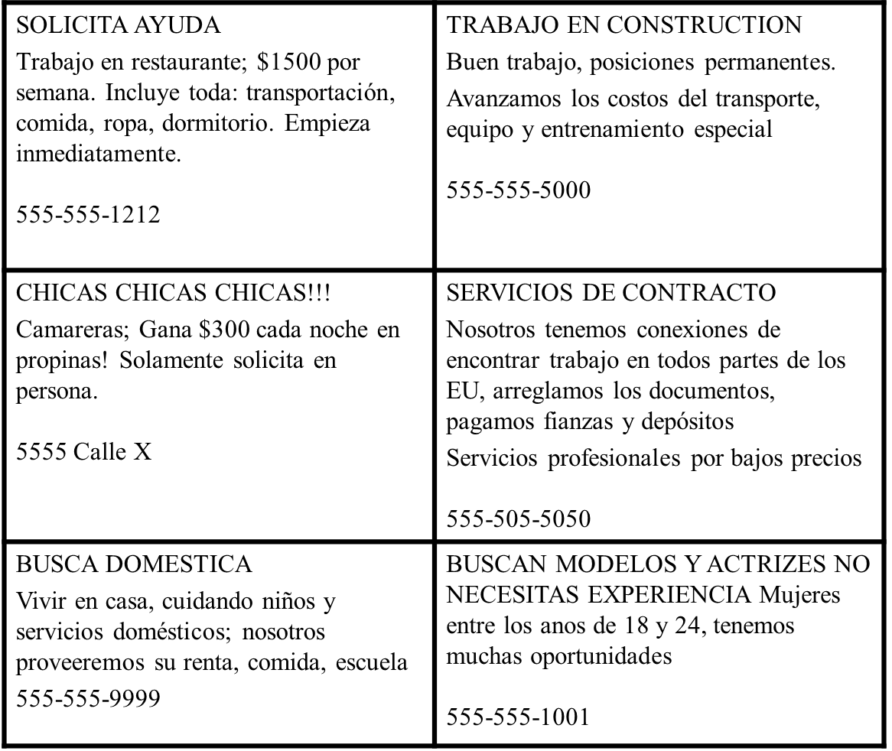
Job Advertisements: Anything wrong?
Notes:
Facilitator Notes: Review the following job advertisements with the group. Encourage them to look for warning signs that indicate possible fraud, lies, and/or overall danger. If they have difficulty in doing so, remind them of warning signs mentioned in previous slide and see if they can identify similar ones in the advertisements.

Slide 23
WHAT DID YOU SEE IN THESE ADVERTISEMENTS?
Pay is too good to be true
Living at Work Site
Missing Information
Offer to fix your documents
WHAT OTHER INFORMATION DO YOU NEED?
Notes:
Facilitators Instructions: Use this summary to review the types of warning signs found in the job advertisements in the previous slide. You can also leverage this conversation to ask:
What types of information do you need to help confirm that an advertisement is real?
What does it mean to advance costs? Why is this dangerous?
Can it be dangerous for someone to live with their boss or on the work site? Why?
What specific dangers did you see in the job advertisements asking for women?

Slide 24

IMPORTANT TIPS TO STAY SAFE
Never go into debt for a job
Keep your own identification documents
Don’t become dependent on your boss for housing
If someone asks you to pay a fee to apply for a job, stay away!
If someone mistreats, hurts, threatens, or tries to control you, Ask for Help!
Notes:
Today you have learned to identify false job offers so you can be informed and protect yourself from exploitation and human trafficking.
There are legitimate and fulfilling opportunities waiting for you, and we want you to be able to concentrate on those. Here are some important tips to stay safe.
Facilitator Instructions: Talk to your audience about important tips to stay safe, including: not going into debt for a job, holding on to identification documents, and avoiding jobs where a fee is required for hiring purposes and where the individual must live on work premises.
Finally, the most important take away is making the audience feel comfortable with asking for help anytime in case of any mistreatment, threats, or abuse.

Slide 25

ASKING FOR HELP
Your Local Human
Trafficking Coalition
&
National Human Trafficking Hotline Number
1-888-3737-888
Notes:
Facilitator Instructions: Please add your agency’s number to this slide.
It does not matter if you have papers or not. All people that work in the United States, including all of you, have the right to:
Be paid at least the minimum wage
Not be held in a job against your will
Keeping your passport and other identification documents in your possession
Leaving an abusive employment situation, and
Getting help!
You can call Catholic Charities OR the National Human Trafficking Hotline for free and confidential support. Call them if:
You have a question about human trafficking
If you see something suspicious and you’d like to report it
And most importantly, you or someone you love is a trafficking victim in need of support.

Slide 26
QUIZ: You can call the National Human Trafficking Hotline or Catholic Charities for which reason?
If you have a question about human trafficking or need help
If you are a trafficking victim in need of help
If you see something suspicious and you’d like to report it
All of the above

Slide 27
QUIZ:
You can call the National Human Trafficking Hotline for which reason?
If you have a question about human trafficking or need help
If you are a trafficking victim in need of help
If you see something suspicious and you’d like to report it
All of the above

Slide 28
The Amistad Movement
WE THANK YOU FOR BEING HERE TODAY!

